Slide 1
crop insurance system
Based on Blockchain and Smart Contracts

Slide 2

crop insurance system
We use blockchain as an emerging technology that enables transparent and secure data storage and transmission. A collaborative blockchain-based crop insurance system for monitoring and processing the insurance transactions. Our solution aims at automating the insurance policy processing, claim handling, and payment using smart contracts to minimize the delay and rejection of crop insurance claims under the Pradhan Mantri Fasal Bima Yojana.

Slide 3
About the project
The generic existing insurance systems require manual interactions across different transaction processes resulting in slow processing and lengthy payment settlement time. We can solve this directly by using Smart Contracts. For example, insurance policies can be transformed into smart contracts that will eventually help in automating claim processing, verification, and payment. It will provide several-fold advantages, for instance, saving time, reducing costs, and preventing potential fraud.
Indeed, a smart contract can be written to register farmers interested in purchasing policies offered by the insurers (Private Insurance Companies with Agriculture Insurance Company under PMFBY), enable them to follow their claims, and automatically receive refunds. More precisely, a smart contract is provided to insurers to team up, pool their contributions/premiums, and protect each other. This smart contract includes a set of the created insurance policies which are the agreements among the insurers and the insured (Farmers). The insurance policy is mapped into a smart contract that communicates with external oracles in order to automatically invoke a new claim and transfer to the insured (i.e., the insurance policy smart contract’s owner) the claimed amount.

Slide 4
Application & working
Terminologies
System model
framework
To know about the application and working of our project we first need to understand some basic terminologies.
All the entities in our system: insured, insurer, third-party web APIs, and auditor
Framework of smart contracts in order to automate the execution of the agreement between the insurer and the insured (Farmers).

Slide 5
Terminologies
blockchain
Blockchain is a distributed and chronological database of transactions where the transactions are stored in blocks. It is almost impossible to tamper with the blocks in blockchain and thus it can be trusted.
Smart contracts
Smart contracts are computer programs deployed on the blockchain. They are triggered and perform pre-defined actions when specific conditions are met. The smart contract functions will always respond when invoked and they cannot be censored or altered once deployed
oracle
Oracles are used to gather information from the real-world and invoke automatically the smart contract pertaining to the claim. Insure chain is another interesting proposal that is based on a smart contract which includes the rules associated with setting the premium and the settlement verification

Slide 6
system model
02
04
insurers
auditors
Private Insurance Companies with Agriculture Insurance Company under PMFBY
This entity investigates and audits the insurance transactions to settle some legal dispute
01
03
Insured (farmers)
api’s
This entity is interested in purchasing policies offered by an insurer
These entities provide specialized services that are useful to invoke claim requests

Slide 7
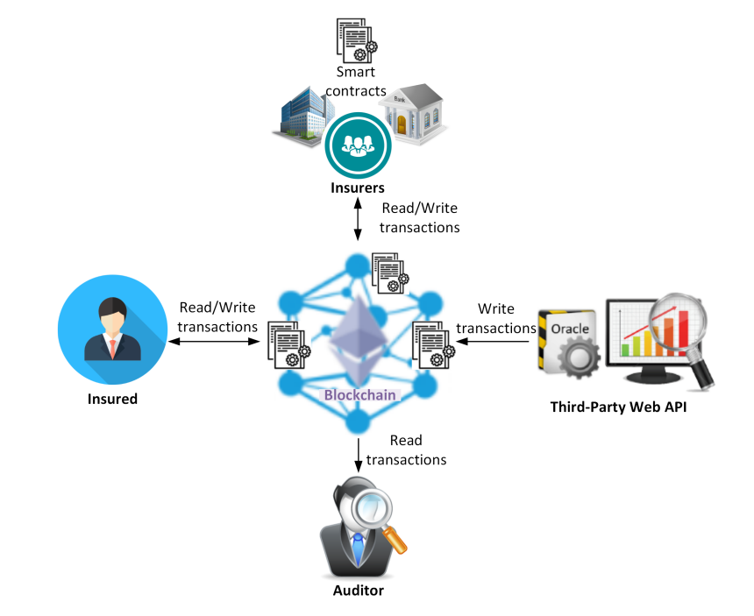
Functional entities

Slide 8
Proposed Smart Contracts
Smart Contracts
In order to automate the execution of the agreement between the insurer (Private Insurance Companies with Agriculture Insurance Company under PMFBY) and the insured (Farmers), three smart contracts are proposed: InsurancePool, InsurancePolicy, and Claim.
Insurance Pool
Insurance Policy
Claim

Slide 9
insurance pool
It is hosted on the blockchain and used by multiple clients interested in proposing multiple insurance offers. The InsurancePool smart contract is designed to enable several insurers (Private Insurance Companies with Agriculture Insurance Company under PMFBY) to collaborate on a common project (PMFBY) that offers a collaborative insurance to refund the insured (Farmers) for possible damage(s) during designated incidents.

Slide 10
insurance policy
It is created for the farmers interested in purchasing policies offered by the insurer and hosted on the blockchain. The InsurancePolicy smart contract is designed to enable the insured, known as the policyholder, to hold a machine-readable and self-enforcing insurance policy. This smart contract defines a set of functions, which allows farmers to pay the premium, cancel the existing policies, claim insurance amount (this function creates/deploys automatically a new instance of the Claim smart contract).

Slide 11
claim
It is created by an InsurancePolicy smart contract and hosted on the blockchain. The Claim smart contract is designed to automate the claim processing, verification, and payment. This smart contract defines a set of functions, authorize function that enables the insurer to update the status of the claim from “Created” to “Open” or to “Rejected”. TriggerPayment function that is automatically invoked in order to refund the claimed amount and ask for closing the claim, closeClaim function that is automatically invoked once the insured is refunded by updating the claim’s status to “Closed”, and cancelClaim function that enables the insured to cancel a claim, then the claim status is updated to “Canceled” and the claim is canceled.

Slide 12
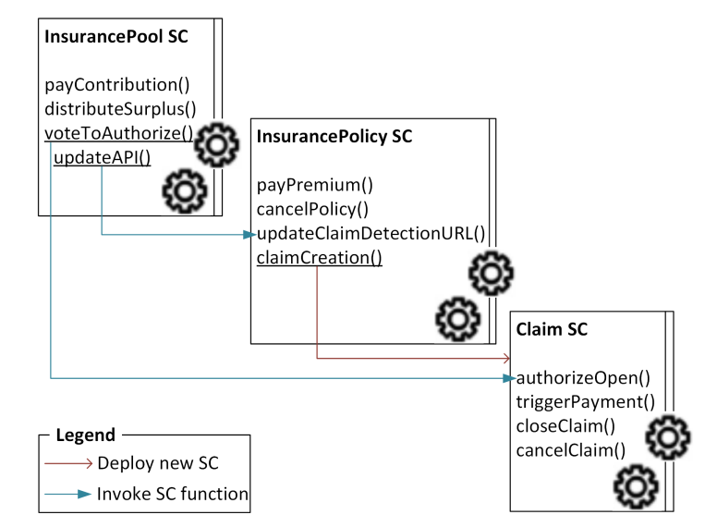

Slide 13
After the smart contract’s functions are executed, we can easily
Track when a crop insurance claim is settled
Track when the insurance company disburses the insurance claim
Track when the settlement amount is credited to the farmers bank account.

Slide 14
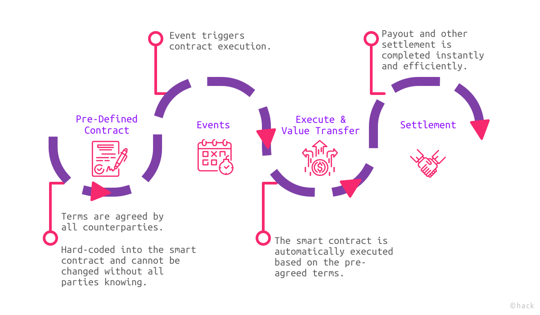
Development phases

Slide 15
Life cycle phases
creation
freezing
execution
finalization

Slide 16
Features
Save time on verifying claims
Risk Assessment
01
02
03
04
05
Less Fraud through Transparency
Task Automation
Protect policy documents

Slide 17

Limited contract scope
Technological complexity
The most significant constraint that can spoil the benefits of using smart contracts in insurance is the necessity to cover every eventuality in a contract’s code. Things that can be done relatively easily on paper can be difficult to translate into code.
Building a sophisticated blockchain smart contract in crop insurance requires a particular level of programming skills. First of all, only specialists well-versed in Ethereum can create a well-run smart contract.
01
04
02
Constraints
03
Uncertainty of legal regulations
Possible bugs in code
Smart contracts are tricky. Since they’re executed sequentially, if at least one vital piece is missing, the contract won’t run.
It’s no secret that the insurance industry is among the most regulated. But despite the keen interest in blockchain technology shown by government institutions, smart contracts are still largely unregulated

Slide 18
Issues
Development
Migration
Legal Regulations
Integration
Although it is simple to automate a transaction, it is difficult to code in a smart contract
It will be hard to migrate farmers , government and insurers to a blockchain based Insurance System. It will be a complex system for them to deal with.
Smart contracts are still largely unregulated
It would hard for government to integrate this blockchain based insurance system with existing systems or to create a new one.

Slide 19
Conclusion
In the next five years, we see smart contracts in the crop insurance sector being developed in relation to short term risks where there are clear parameters as to payment, the potential for disputes is low and the claims management process is uncomplicated or pre-determined.
Perhaps the main obstacle to smart contracts becoming the norm in the insurance market is that decision makers may not commit sufficient human and financial capital to their development. As smart contracts represent more of a revolution than an evolution in the way business is transacted, they will require significant strategic long-term resources committed to their development.

Slide 20
thank you
All the details about our project which includes pdf file , PowerPoint presentation and word document is available in our GitHub repository : https://github.com/0xaira/Crop-Insurance-Dapp

